Slide 1
L04 Edges, Corners, and Blobs

Slide 2
Edge Detection
Slides from Svetlana Lazebnik

Slide 3
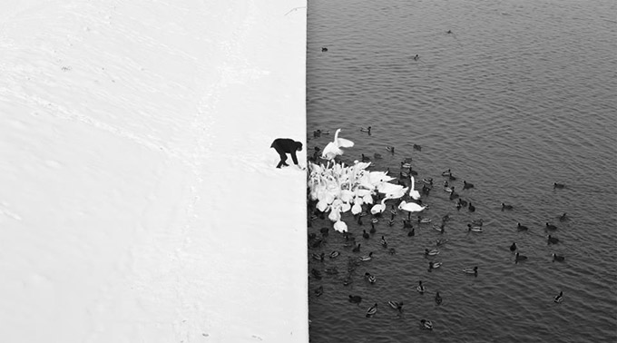
Edge Detection
Winter in Kraków photographed by Marcin Ryczek

Slide 4
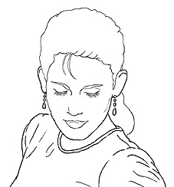
Edge Detection
Goal: Identify sudden changes (discontinuities) in an image
  Intuitively, most semantic and shape information from the image can be encoded in the edges
  More compact than pixels
Ideal: artist’s line drawing (but artist is also using object-level knowledge)
Source: D. Lowe

Slide 5
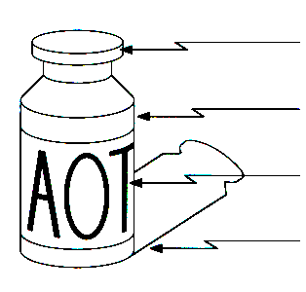
Origin of Edges
Edges are caused by a variety of factors:
surface normal discontinuity
depth discontinuity
surface color discontinuity
illumination discontinuity
Source: Steve Seitz

Slide 6

Edge Detection
An edge is a place of rapid change in the image intensity function
intensity function
(along horizontal scanline)
image
first derivative
edges correspond to
extrema of derivative

Slide 7
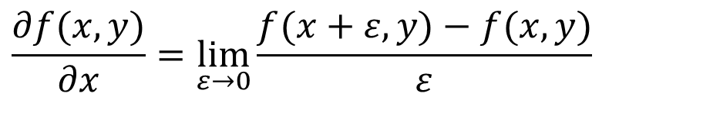
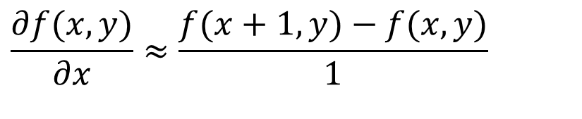
Derivatives with Convolution
For 2D function f(x,y), the partial derivative is:
For discrete data, we can approximate using finite differences:
To implement the above as convolution, what would be
the associated filter?
$$\frac{∂f(x,y)}{∂x}=\lim_{ε→0}{\frac{f(x+ε,y)−f(x,y)}{ε}}$$
$$\frac{∂f(x,y)}{∂x}≈\frac{f(x+1,y)−f(x,y)}{1}$$
Source: K. Grauman

Slide 8
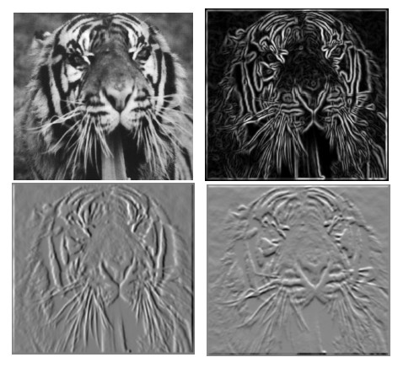


Partial Derivatives of an Image
$$y$$
$$x$$
-1 1
1 -1
-1 1
or
Which shows changes with respect to x?

Slide 9
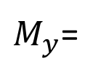

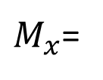

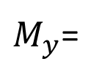
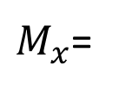
Finite Difference Filters
$$y$$
Other approximations of derivative filters
-1 | -1 | -1
0 | 0 | 0
1 | 1 | 1
-1 | 0 | 1
-1 | 0 | 1
-1 | 0 | 1
$$x$$
Prewitt
$M_{x}$=
$M_{y}$=
-1 | -2 | -1
0 | 0 | 0
1 | 2 | 1
-1 | 0 | 1
-2 | 0 | 2
-1 | 0 | 1
Sobel
$M_{x}$=
$M_{y}$=

Slide 10
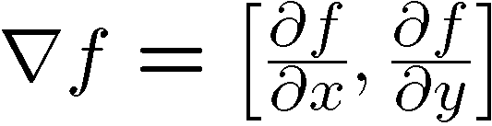
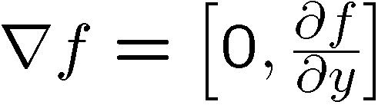

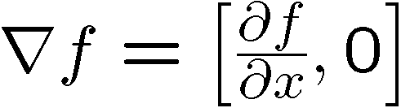
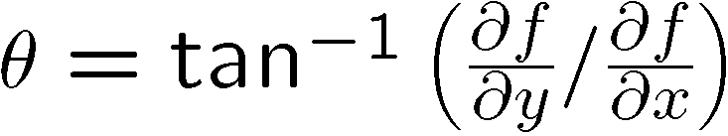
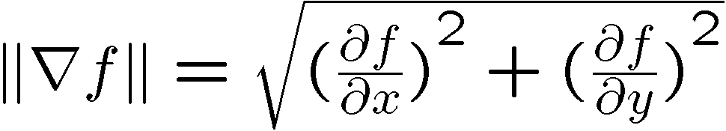
Image Gradient
The gradient of an image:
The gradient points in the direction of most rapid increase in intensity.
How does this direction relate to the direction of the edge?
The gradient direction is given by
The edge strength is given by the gradient magnitude
Source: Steve Seitz

Slide 11
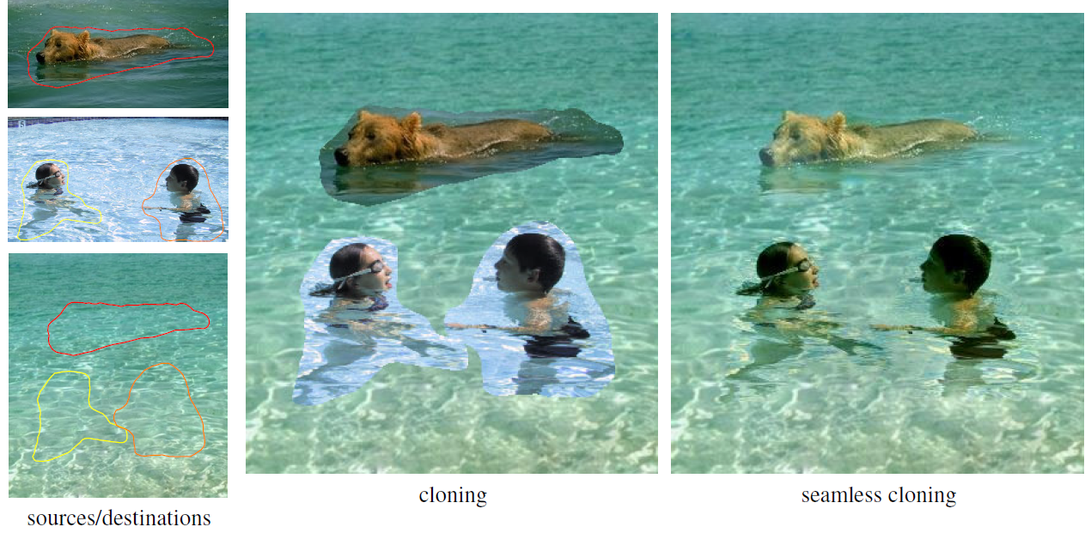
Application: Gradient-Domain Image Editing
Goal: solve for pixel values in the target region to match gradients of the source region while keeping background pixels the same
P. Perez, M. Gangnet, A. Blake, Poisson Image Editing, SIGGRAPH 2003

Slide 12

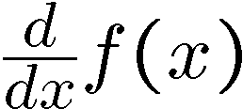
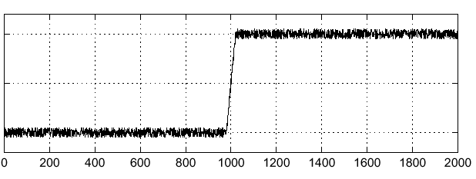
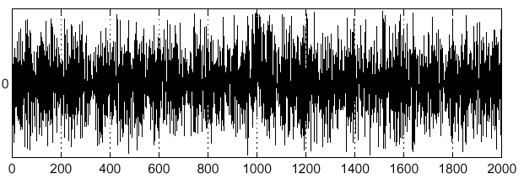
Effects of Noise
Consider a single row or column of the image
Where is the edge?
Source: S. Seitz
Notes:
How to fix?

Slide 13
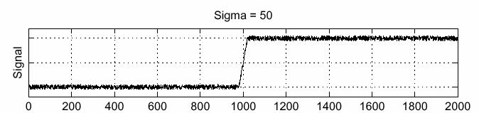
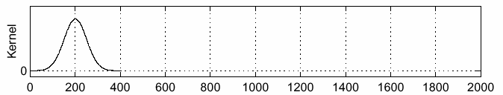
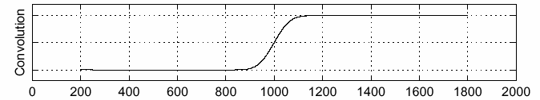
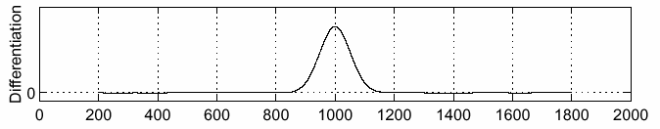
Solution: Smooth First
f
g
f * g
To find edges, look for peaks in
Source: S. Seitz

Slide 14
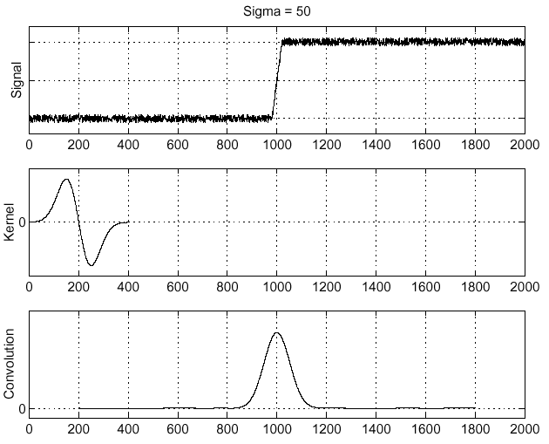
Derivative Theorem of Convolution
Differentiation is convolution, and convolution is associative:
This saves us one operation:
f
Source: S. Seitz

Slide 15
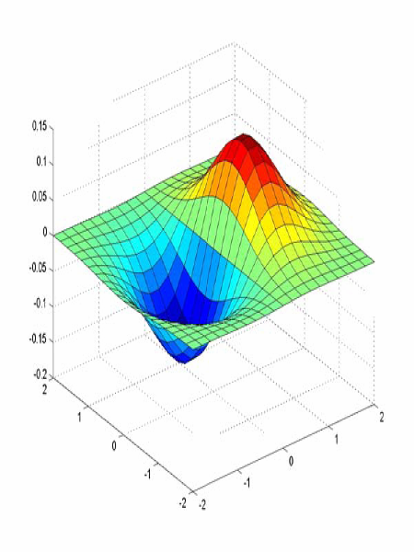
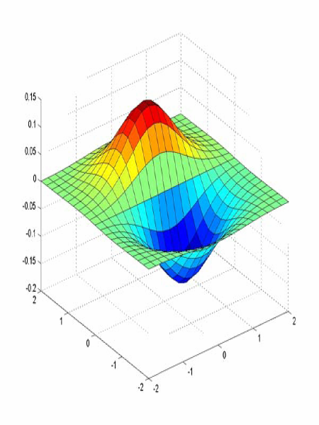
Derivative of Gaussian Filters
x-direction
y-direction
Which one finds horizontal/vertical edges?

Slide 16
Derivative of Gaussian Filters
x-direction
y-direction
Are these filters separable?

Slide 17
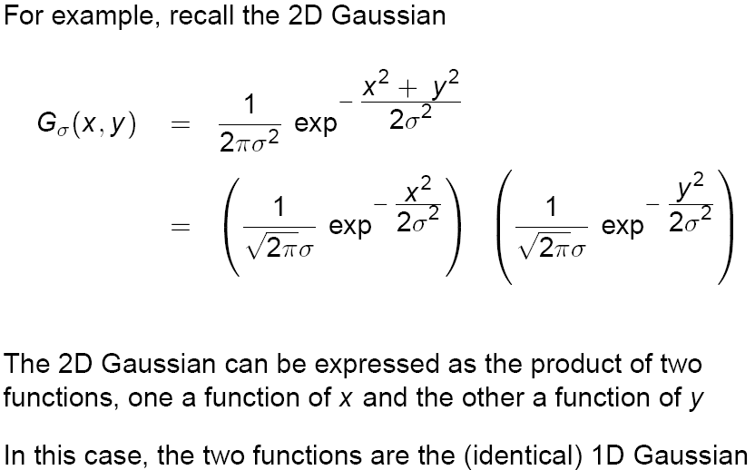
Recall: Separability of the Gaussian Filter
Source: D. Lowe

Slide 18
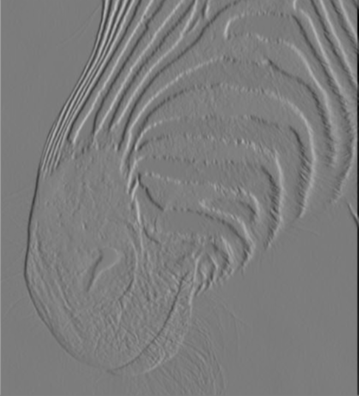
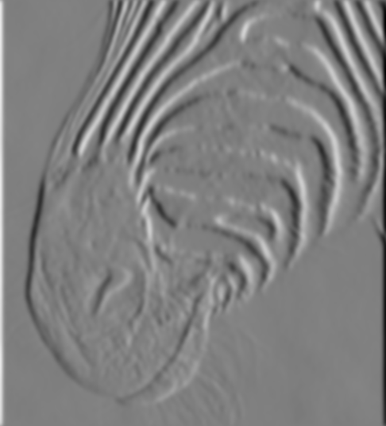
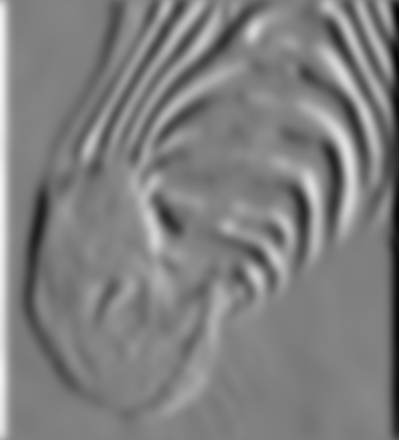
Scale of Gaussian Derivative Filter
1 pixel
3 pixels
7 pixels
Smoothed derivative removes noise, but blurs edge. Also finds edges at different “scales”
Source: D. Forsyth

Slide 19
Review: Smoothing vs. Derivative Filters
Smoothing filters
  Gaussian: remove “high-frequency” components;
  “low-pass” filter
  Can the values of a smoothing filter be negative?
  What should the values sum to?
    One: constant regions are not affected by the filter
Derivative filters
  Derivatives of Gaussian
  Can the values of a derivative filter be negative?
  What should the values sum to?
    Zero: no response in constant regions
  High absolute value at points of high contrast

Slide 20
The Canny Edge Detector
Filter image with derivative of Gaussian
Find magnitude and orientation of gradient
Non-maximum suppression:
  Thin wide “ridges” down to single pixel width
Linking and thresholding (hysteresis):
  Define two thresholds: low and high
  Use the high threshold to start edge curves and the low threshold to continue them
J. Canny, A Computational Approach To Edge Detection, IEEE Trans. Pattern Analysis and Machine Intelligence, 8:679-714, 1986.

Slide 21
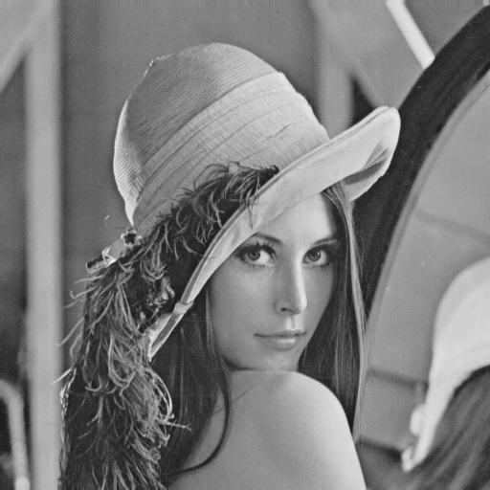
The Canny Edge Detector
original image
Slide credit: Steve Seitz

Slide 22
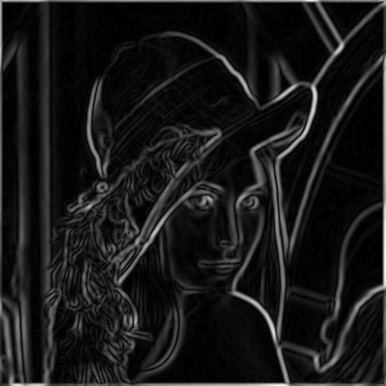
The Canny Edge Detector
norm of the gradient

Slide 23
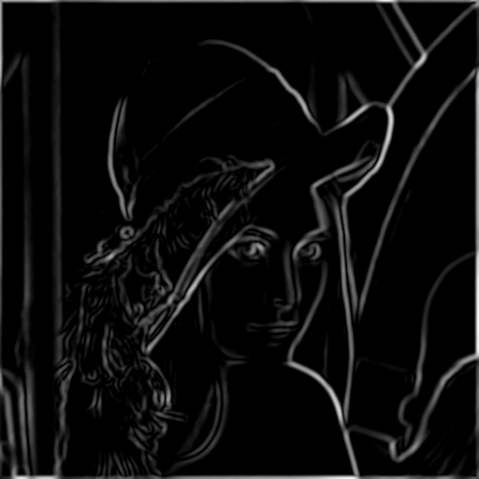
The Canny Edge Detector
thresholding

Slide 24

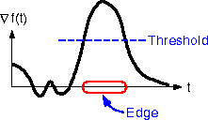
The Canny Edge Detector
How to turn these thick regions of the gradient into curves?
thresholding

Slide 25

Non-Maximum Suppression
Check if pixel is local maximum along gradient direction, select single max across width of the edge
  requires checking interpolated pixels p and r

Slide 26
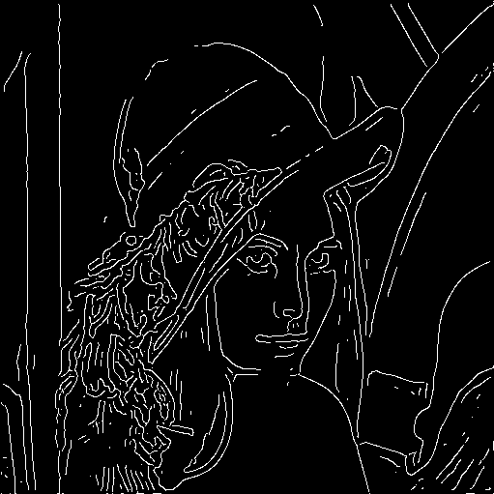
The Canny Edge Detector
Problem: pixels along this edge didn’t survive the thresholding
thinning
(non-maximum suppression)

Slide 27
Hysteresis Thresholding
Use a high threshold to start edge curves, and a low threshold to continue them.
Source: Steve Seitz

Slide 28
Hysteresis Thresholding
original image
high threshold
(strong edges)
low threshold
(weak edges)
hysteresis threshold
Source: L. Fei-Fei

Slide 29
Recap: Canny Edge Detector
Compute x and y gradient images
Find magnitude and orientation of gradient
Non-maximum suppression:
  Thin wide “ridges” down to single pixel width
Linking and thresholding (hysteresis):
  Define two thresholds: low and high
  Use the high threshold to start edge curves and the low threshold to continue them
J. Canny, A Computational Approach To Edge Detection, IEEE Trans. Pattern Analysis and Machine Intelligence, 8:679-714, 1986.

Slide 30
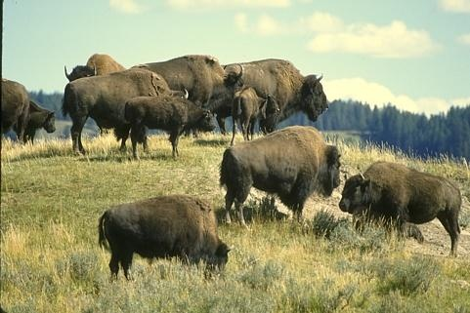
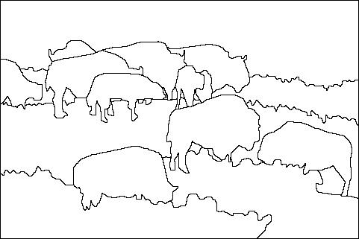
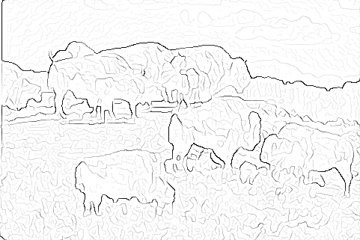

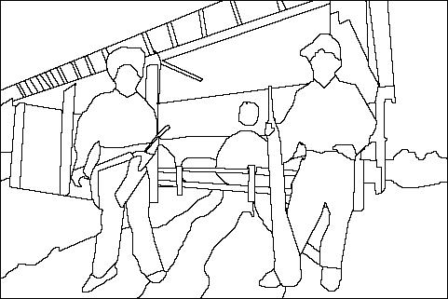
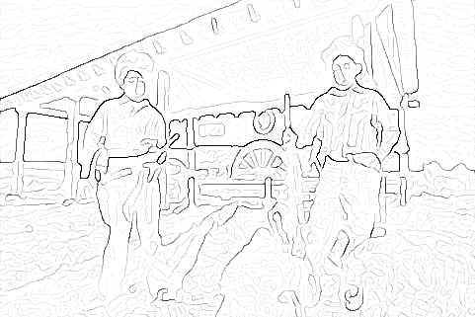
Image Gradients vs. Meaningful Contours
image
human segmentation
gradient magnitude
Berkeley segmentation database:
http://www.eecs.berkeley.edu/Research/Projects/CS/vision/grouping/segbench/

Slide 31
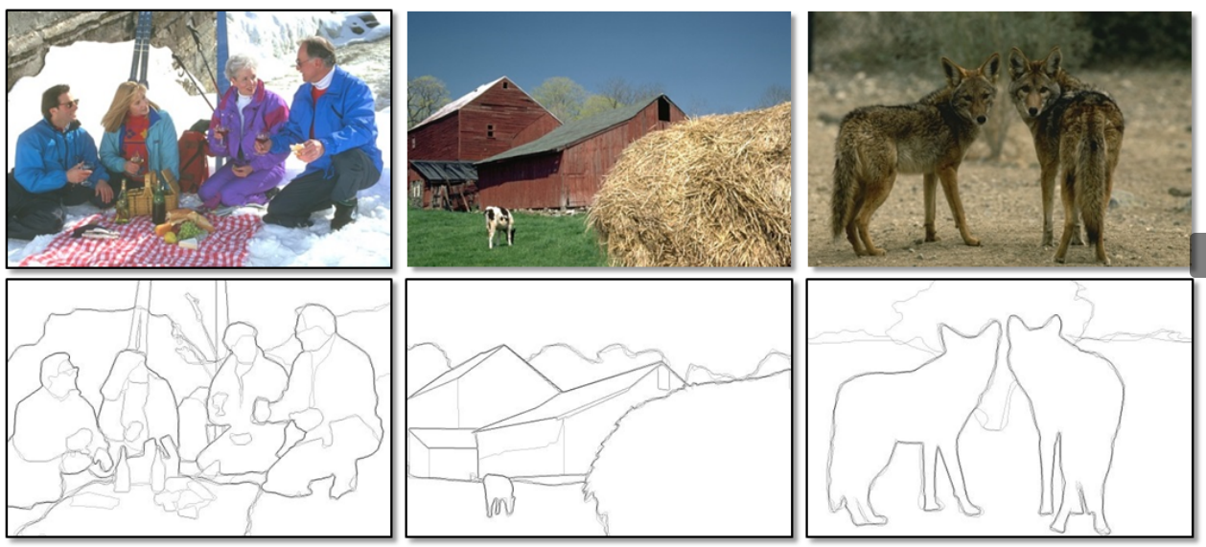
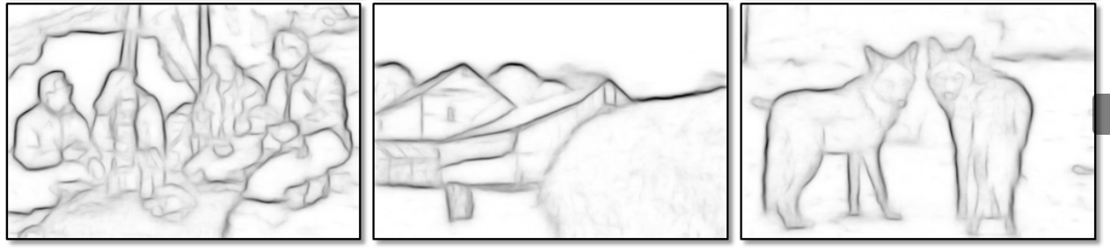
Data-Driven Edge Detection
Input images
Training data
Ground truth
Output
P. Dollar and L. Zitnick, Structured forests for fast edge detection, ICCV 2013

Slide 32
Corners
Slides are from Svetlana Lazebnik

Slide 33
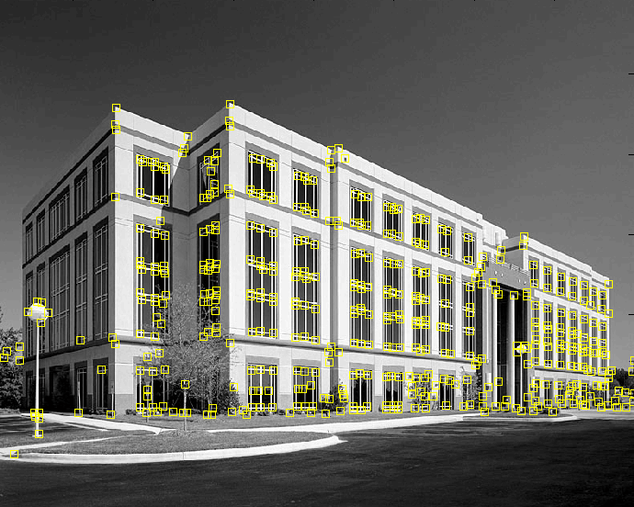
Feature Extraction: Corners
9300 Harris Corners Pkwy, Charlotte, NC

Slide 34
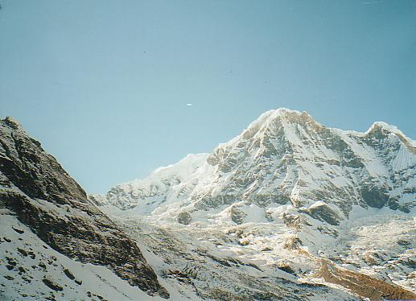
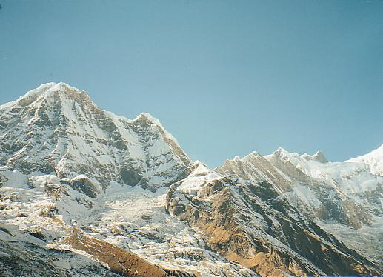
Why Extract Features?
Motivation: panorama stitching
  We have two images – how do we combine them?

Slide 35
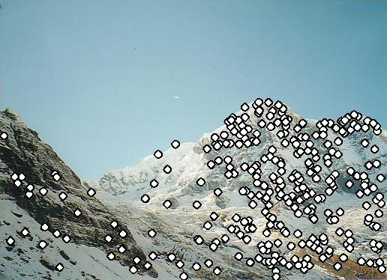
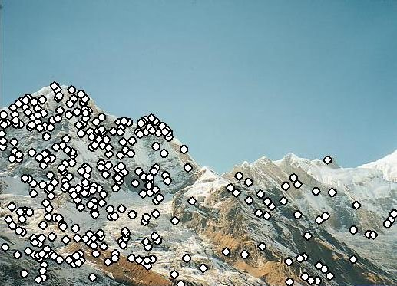
Why Extract Features?
Motivation: panorama stitching
  We have two images – how do we combine them?
Step 1: extract features
Step 2: match features

Slide 36
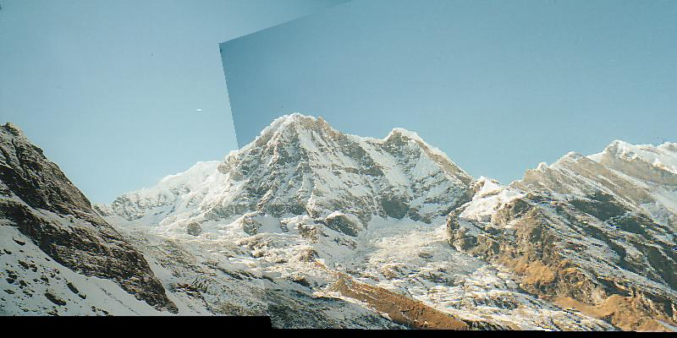
Why Extract Features?
Motivation: panorama stitching
  We have two images – how do we combine them?
Step 1: extract features
Step 2: match features
Step 3: align images

Slide 37
Characteristics of Good Features
Repeatability
  The same feature can be found in several images despite geometric and photometric transformations
Saliency
  Each feature is distinctive
Compactness and efficiency
  Many fewer features than image pixels
Locality
  A feature occupies a relatively small area of the image; robust to clutter and occlusion

Slide 38
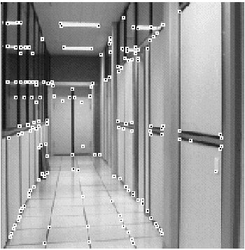
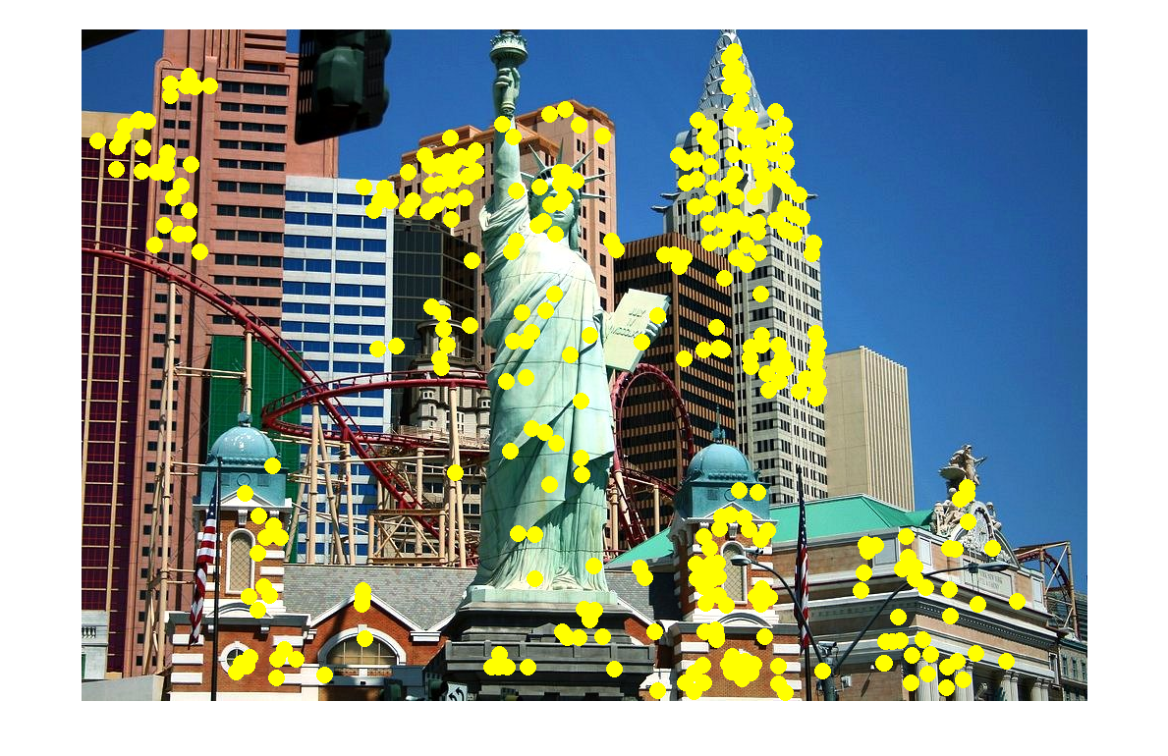

Applications
Feature points are used for:
  Image alignment
  3D reconstruction
  Motion tracking
  Robot navigation
  Indexing and database retrieval
  Object recognition

Slide 39


A Hard Feature Matching Problem
NASA Mars Rover images

Slide 40


Answer Below (Look for Tiny Colored Squares …)
NASA Mars Rover images
with SIFT feature matches
Figure by Noah Snavely

Slide 41

Corner Detection: Basic Idea
We should easily recognize the point by looking through a small window
Shifting a window in any direction should give a large change in intensity
“flat” region:
no change in all directions
“edge”:
no change along the edge direction
“corner”:
significant change in all directions

Slide 42



Corner Detection: Mathematics
Change in appearance of window W for the shift [u,v]:
$$E(u,v)=\sum_{(x,y)∈W}{[I(x+u,y+v)−I(x,y)]^{2}}$$
I(x, y)
E(u, v)
E(3,2)

Slide 43
Corner Detection: Mathematics
Change in appearance of window W for the shift [u,v]:
$$E(u,v)=\sum_{(x,y)∈W}{[I(x+u,y+v)−I(x,y)]^{2}}$$
I(x, y)
E(u, v)
E(0,0)

Slide 44
Corner Detection: Mathematics
Change in appearance of window W for the shift [u,v]:
$$E(u,v)=\sum_{(x,y)∈W}{[I(x+u,y+v)−I(x,y)]^{2}}$$
We want to find out how this function behaves for small shifts
E(u, v)
Notes:
Specifically, E has to have a unique minimum at (0,0)

Slide 45

Corner Detection: Mathematics
First-order Taylor approximation for small motions [u, v]:
Let’s plug this into E(u,v):
$$E(u,v)=\sum_{(x,y)∈W}{[I(x+u,y+v)−I(x,y)]^{2}} \\ ≈\sum_{(x,y)∈W}{[I(x,y)+I_{x}u+I_{y}v−I(x,y)]^{2}} \\ =\sum_{(x,y)∈W}{[I_{x}u+I_{y}v]^{2}}=\sum_{(x,y)∈W}{I_{x}^{2}u^{2}+2I_{x}I_{y}uv+I_{y}^{2}v^{2}}$$

Slide 46


Corner Detection: Mathematics
The quadratic approximation can be written as
$$E(u,v)≈\left[\begin{matrix}u & v\end{matrix}\right]M\left[\begin{matrix}u \\ v\end{matrix}\right]$$
where M is a second moment matrix computed from image derivatives:
$$M=\left[\begin{matrix}\sum_{x,y}{I_{x}^{2}} & \sum_{x,y}{I_{x}I_{y}} \\ \sum_{x,y}{I_{x}I_{y}} & \sum_{x,y}{I_{y}^{2}}\end{matrix}\right]$$
(the sums are over all the pixels in the window W)

Slide 47



Interpreting the Second Moment Matrix
The surface E(u,v) is locally approximated by a quadratic form. Let’s try to understand its shape.
  Specifically, in which directions
  does it have the smallest/greatest
  change?
E(u, v)
$$E(u,v) ≈ [u v] M \left[\begin{matrix}u \\ v\end{matrix}\right]$$
$$M=\left[\begin{matrix}\sum_{x,y}{I_{x}^{2}} & \sum_{x,y}{I_{x}I_{y}} \\ \sum_{x,y}{I_{x}I_{y}} & \sum_{x,y}{I_{y}^{2}}\end{matrix}\right]$$

Slide 48


Interpreting the Second Moment Matrix
First, consider the axis-aligned case (gradients are either horizontal or vertical)
$$M=\left[\begin{matrix}\sum_{x,y}{I_{x}^{2}} & \sum_{x,y}{I_{x}I_{y}} \\ \sum_{x,y}{I_{x}I_{y}} & \sum_{x,y}{I_{y}^{2}}\end{matrix}\right]$$
$$=\left[\begin{matrix}a & 0 \\ 0 & b\end{matrix}\right]$$
If either a or b is close to 0, then this is not a corner, so look for locations where both are large.

Slide 49

Interpreting the Second Moment Matrix
Consider a horizontal “slice” of E(u, v):
This is the equation of an ellipse.

Slide 50
Interpreting the Second Moment Matrix
Consider a horizontal “slice” of E(u, v):
This is the equation of an ellipse.
Diagonalization of M:
The axis lengths of the ellipse are determined by the eigenvalues and the orientation is determined by R
direction of the fastest change
direction of the slowest change
(λ_{max})^{-1/2}
(λ_{min})^{-1/2}

Slide 51

Visualization of Second Moment Matrices

Slide 52

Visualization of Second Moment Matrices

Slide 53
Interpreting the Eigenvalues
Classification of image points using eigenvalues of M:
λ₂
“Edge”
λ₂ >> λ₁
“Corner”
λ₁ and λ₂ are large,
λ₁ ~ λ₂;
E increases in all directions
λ₁ and λ₂ are small;
E is almost constant in all directions
“Flat” region
“Edge”
λ₁ >> λ₂
λ₁

Slide 54
Corner Response Function
$$R=\det{(}M)−α\operatorname{trace}{(}M)^{2}=λ_{1}λ_{2}−α(λ_{1}+λ_{2})^{2}$$
α: constant (0.04 to 0.06)
“Edge”
R < 0
“Corner”
R > 0
|R| small
“Flat” region
“Edge”
R < 0

Slide 55

The Harris Corner Detector
Compute partial derivatives at each pixel
Compute second moment matrix M in a Gaussian window around each pixel:
$$M=\left[\begin{matrix}\sum_{x,y}{w(x,y)I_{x}^{2}} & \sum_{x,y}{w(x,y)I_{x}I_{y}} \\ \sum_{x,y}{w(x,y)I_{x}I_{y}} & \sum_{x,y}{w(x,y)I_{y}^{2}}\end{matrix}\right]$$
C.Harris and M.Stephens. “A Combined Corner and Edge Detector.” Proceedings of the 4th Alvey Vision Conference: pages 147—151, 1988.

Slide 56
The Harris Corner Detector
Compute partial derivatives at each pixel
Compute second moment matrix M in a Gaussian window around each pixel
Compute corner response function R
C. Harris and M. Stephens. “A Combined Corner and Edge Detector.” Proceedings of the 4th Alvey Vision Conference: pages 147—151, 1988.

Slide 57

Harris Detector: Steps

Slide 58

Harris Detector: Steps
Compute corner response R

Slide 59
The Harris Corner Detector
Compute partial derivatives at each pixel
Compute second moment matrix M in a Gaussian window around each pixel
Compute corner response function R
Threshold R
Find local maxima of response function (nonmaximum suppression)
C.Harris and M.Stephens. “A Combined Corner and Edge Detector.” Proceedings of the 4th Alvey Vision Conference: pages 147—151, 1988.

Slide 60

Harris Detector: Steps
Find points with large corner response: R > threshold

Slide 61

Harris Detector: Steps
Take only the points of local maxima of R

Slide 62

Harris Detector: Steps

Slide 63
Invariance and Covariance
We want corner locations to be invariant to photometric transformations and covariant to geometric transformations
  Invariance: image is transformed and corner locations do not change
  Covariance: if we have two transformed versions of the same image, features should be detected in corresponding locations

Slide 64

Activity
Is Harris corner detection invariant to
Affine intensity changes $I  a I + b$
Image translation
Image rotation
Image scaling

Slide 65


Affine Intensity Change
$$I  a I + b$$
Only derivatives are used => invariance to intensity shift $I  I + b$
Intensity scaling: $I  a I$
R
R
threshold
x (image coordinate)
x (image coordinate)
Partially invariant to affine intensity change

Slide 66
Image Translation
Derivatives and window function are shift-invariant
Corner location is covariant w.r.t. translation

Slide 67
Image Rotation
Second moment ellipse rotates but its shape (i.e. eigenvalues) remains the same
Corner location is covariant w.r.t. rotation

Slide 68
Scaling
Corner
All points will be classified as edges
Corner location is not covariant to scaling!

Slide 69
Blob Detection
Slides from Svetlana Lazebnik

Slide 70

Blob Detection

Slide 71
Feature Detection with Scale Selection
We want to extract features with characteristic scale that is covariant with the image transformation

Slide 72

Blob Detection: Basic idea
To detect blobs, convolve the image with a “blob filter” at multiple scales and look for extrema of filter response in the resulting scale space.

Slide 73



Blob Detection: Basic Idea
minima
*
=
maxima
Find maxima and minima of blob filter response in space and scale
Source: N. Snavely

Slide 74

Blob Filter
Laplacian of Gaussian: Circularly symmetric operator for blob detection in 2D

Slide 75
Recall: Edge Detection
Edge
f
Derivative
of Gaussian
Edge = maximum
of derivative
Source: S. Seitz

Slide 76

Edge Detection, Take 2
f
Edge
Second derivative
of Gaussian
(Laplacian)
Edge = zero crossing
of second derivative
Source: S. Seitz
Notes:
An edge filtered with the Laplacian of Gaussian is the difference between the blurry edge and the original edge.

Slide 77

From Edges to Blobs
Edge = ripple
Blob = superposition of two ripples
maximum
Spatial selection: the magnitude of the Laplacian response will achieve a maximum at the center of the blob, provided the scale of the Laplacian is “matched” to the scale of the blob

Slide 78

Scale Selection
We want to find the characteristic scale of the blob by convolving it with Laplacians at several scales and looking for the maximum response
However, Laplacian response decays as scale increases:
original signal
(radius=8)
increasing σ

Slide 79

Scale Normalization
The response of a derivative of Gaussian filter to a perfect step edge decreases as σ increases
Notes:
The area under the first derivative of Gaussian from –infinity to 0 is equal to the value of the Gaussian at zero

Slide 80
Scale Normalization
The response of a derivative of Gaussian filter to a perfect step edge decreases as σ increases
To keep response the same (scale-invariant), must multiply Gaussian derivative by σ
Laplacian is the second Gaussian derivative, so it must be multiplied by σ²

Slide 81

Effect of Scale Normalization
Original signal
Unnormalized Laplacian response
Scale-normalized Laplacian response
maximum

Slide 82
Blob Detection in 2D
Laplacian of Gaussian: Circularly symmetric operator for blob detection in 2D
Scale-normalized:

Slide 83
Scale Selection
At what scale does the Laplacian achieve a maximum response to a binary circle of radius r?
r
image
Laplacian

Slide 84
Scale Selection
At what scale does the Laplacian achieve a maximum response to a binary circle of radius r?
To get maximum response, the zeros of the Laplacian have to be aligned with the circle
The Laplacian is given by (up to scale):
Therefore, the maximum response occurs at
circle
r
0
Laplacian
image

Slide 86

Characteristic Scale
We define the characteristic scale of a blob as the scale that produces peak of Laplacian response in the blob center
characteristic scale
T. Lindeberg (1998). "Feature detection with automatic scale selection." International Journal of Computer Vision 30 (2): pp 77--116.

Slide 87
Scale-Space Blob Detector
Convolve image with scale-normalized Laplacian at several scales

Slide 88

Scale-Space Blob Detector: Example

Slide 89










Scale-Space Blob Detector: Example

Slide 90

Scale-Space Blob Detector
Convolve image with scale-normalized Laplacian at several scales
Find maxima of squared Laplacian response in scale-space

Slide 91

Scale-Space Blob Detector: Example

Slide 92






Coin Detection Problem.
Assume that we are given an image containing more than one each of quarters, dimes, nickels, and pennies. Also, you are given template images of these coins in a standard 300x300 canvas.
Your task is to detect each coin and tell me the amount of money represented in the image.
Then, tell me what the assumptions are.

Slide 93

Efficient Implementation
Approximating the Laplacian with a difference of Gaussians:
(Laplacian)
(Difference of Gaussians)

Slide 94

Efficient Implementation
David G. Lowe. "Distinctive image features from scale-invariant keypoints.” IJCV 60 (2), pp. 91-110, 2004.

Slide 95


From Feature Detection to Feature Description
Scaled and rotated versions of the same neighborhood will give rise to blobs that are related by the same transformation
What to do if we want to compare the appearance of these image regions?
  Normalization: transform these regions into same-size circles
  Problem: rotational ambiguity

Slide 96

Eliminating Rotation Ambiguity
To assign a unique orientation to circular image windows:
  Create histogram of local gradient directions in the patch
  Assign canonical orientation at peak of smoothed histogram
0
2
π

Slide 97


SIFT Features
Detected features with characteristic scales and orientations:
David G. Lowe. "Distinctive image features from scale-invariant keypoints.” IJCV 60 (2), pp. 91-110, 2004.

Slide 98

From Feature Detection to Feature Description
Detection is covariant:
  features(transform(image)) = transform(features(image))
Description is invariant:
  features(transform(image)) = features(image)

Slide 99

SIFT Descriptors
David G. Lowe. "Distinctive image features from scale-invariant keypoints.” IJCV 60 (2), pp. 91-110, 2004.

Slide 100


Properties of SIFT
Extraordinarily robust detection and description technique
  Can handle changes in viewpoint
    Up to about 60 degree out-of-plane rotation
  Can handle significant changes in illumination
    Sometimes even day vs. night
  Fast and efficient—can run in real time
  Lots of code available
Source: N. Snavely

Slide 101


Affine adaptation
Affine transformation approximates viewpoint changes for roughly planar objects and roughly orthographic cameras

Slide 102
Affine Adaptation
Consider the second moment matrix of the window containing the blob:
direction of the fastest change
Recall:
direction of the slowest change
(λ_{max})^{-1/2}
(λ_{min})^{-1/2}
This ellipse visualizes the “characteristic shape” of the window

Slide 103
Affine Adaptation Example
Scale-invariant regions (blobs)

Slide 104

Affine Adaptation Example
Affine-adapted blobs

